Slide 1

Dr. Sajid Iqbal
Department of Computer Science
Bahauddin Zakariya University, Multan

Slide 2
Computer Programming
Nested loops

Slide 3
What is nested loop?
Simple loop
A loop structure which has programming statements in its body that do not contain another loop
Nested loop
When a loop is used within the body of other loop, it is called the nested loop
Inner loop: The loop which is nested
Outer loop: the loop which contains another loop
Condition
False
True
Loop Body
Instructions after loop body

Slide 4
Example – Simple Loop
a=1 while(a<=5): print("#") a=a+1 print("five times # is printed")
A<=5
False
True
#
#
#
#
#
five times # is printed
print("#") a=a+1
print("five times # is printed")

Slide 5
Nested Loop
Condition
A loop within another loop
Inner loop
Outer loop
Nesting can be more
than 2 levels
False
True
Condition
False
True
Loop Body
Instructions after loop body
Instructions after loop body

Slide 6
Nested Loops
6
A<=5
a=1 while(a<=5): b = 1 while(b<=3): print("#") b=b+1 a=a+1 print("Fifteen times # is printed")
False
True
b=1
b<=3
#
#
#
.
.
.
#
#
Fifteen times # is printed
False
True
print("#“)
b=b+1
a=a+1
print("Fifteen times # is printed")

Slide 7
More Examples
You can nest the loops to any level i.e. 2 level, 3 level or n-level
Write a program to print tables of 2,3,4,5
Do the followings
Identify the inner loop and outer loop
Draw its flow chart
Run this loop theoretically to see its working
Change this code to print tables of 5-10
Change the inner code to print each table from 1-40
Change the code to print tables in the order 5,4,3,2
Print the tables with range from 20 to 1
a=2 while(a<=5): b=1 while(b<=10): print(a,"*",b,"=",a*b) b=b+1 a=a+1 print("tables of 2,3,4,5 printed")

Slide 8
Another Example
Find the sum of factorial of numbers, 1,2,3,4,5
num=1 sum=0 while(num<=5): fact=1 b=num while(b>=1): fact=fact*b b=b-1 print("factorial of ",num,"is",fact) sum=sum+fact num=num+1 print("sum of factorials",sum)
Alter the code to print sum of factorials of first ten integers (1,2,3,4,5,6,7,8,9,10)
Change the program to print each step of factorial calculation
Draw its flow chart
Change code to print all intermediate sums.
factorial of 1 is 1
factorial of 2 is 2
factorial of 3 is 6
factorial of 4 is 24
factorial of 5 is 120
sum of factorials 153

Slide 9
Print statement
print("hello") print("world")
This statement is used to print something on console
Each print statement prints on new line
We can print things on same line
Printing data on same line
hello
world
print("hello",end='') print("world",end='') print(" on same line")
helloworld on same line

Slide 10
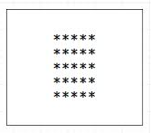
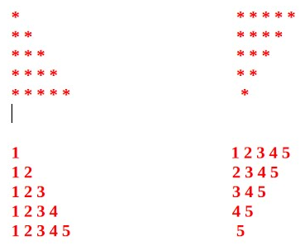
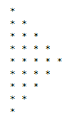
More examples
Using print statement as explained in previous slide and nested loops, print following patters

Slide 11



Thanks for watching
Dr. Sajid Iqbal
Assistant Professor
Department of Computer Science
Bahauddin Zakariya University, Multan
sajidiqbal.pk@gmail.com
https://github.com/sajjo79/Introduction-to-Computers
Allah Hafiz
COMEDXD

